Slide 1

COMPUTER NETWORKS MODULE 3 PHYSICAL LAYER
By
Dr. Kanchan Shende

Slide 2
Analog Data Transmission
Analog transmission is a method of conveying voice, data, image, signal, or video information.
It uses a continuous signal varying in amplitude, phase, or another property that is in proportion to a specific characteristic of a variable.
Analog transmission could mean that the transmission is a transfer of an analog source signal which uses an analog modulation method (or a variance of one or more properties of high frequency periodic waveform, also known as a carrier signal).
SOCS, MIT-WPU

Slide 3
Conti…
Digital-to-Analog Conversion
When data from one computer is sent to another via some analog carrier, it is first converted into analog signals. Analog signals are modified to reflect digital data.
An analog signal is characterized by its amplitude, frequency, and phase.
There are three kinds of digital-to-analog conversions:
Amplitude Shift Keying
Frequency Shift Keying
Phase Shift Keying
SOCS, MIT-WPU

Slide 4
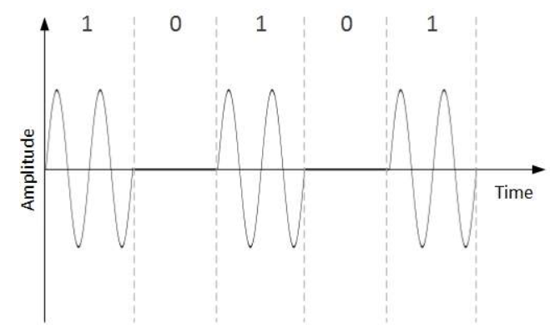
Conti…
Amplitude Shift Keying
In this conversion technique, the amplitude of analog carrier signal is modified to reflect binary data.
When binary data represents digit 1, the amplitude is held; otherwise it is set to 0. Both frequency and phase remain same as in the original carrier signal.
SOCS, MIT-WPU

Slide 5
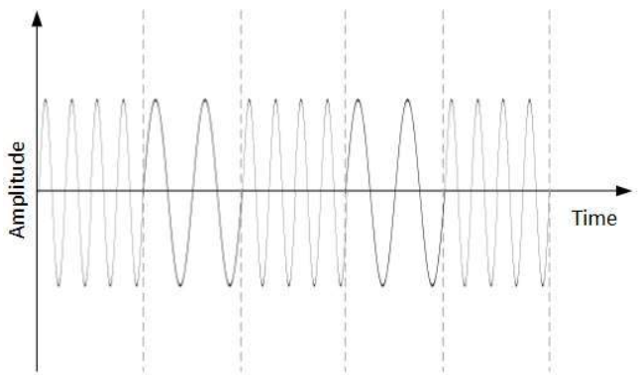
Conti…
2. Frequency Shift Keying
In this conversion technique, the frequency of the analog carrier signal is modified to reflect binary data.
This technique uses two frequencies, f1 and f2. One of them, for example f1, is chosen to represent binary digit 1 and the other one is used to represent binary digit 0. Both amplitude and phase of the carrier wave are kept intact.
SOCS, MIT-WPU

Slide 6
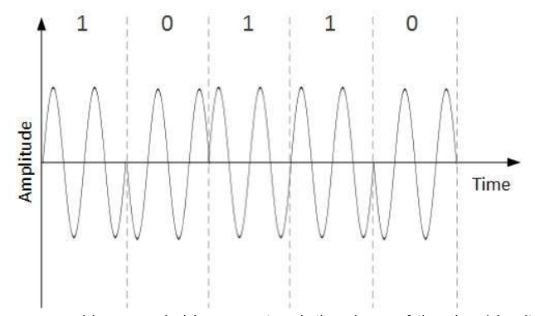
Conti…
2. Phase Shift Keying
In this conversion scheme, the phase of the original carrier signal is altered to reflect the binary data.
When a new binary symbol is encountered, the phase of the signal is altered. Amplitude and frequency of the original carrier signal is kept intact.
SOCS, MIT-WPU

Slide 7
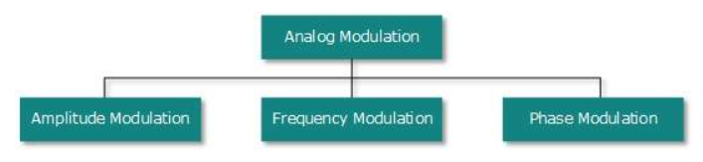
Conti…
Analog to Analog Conversion
Analog signals are modified to represent analog data.
This conversion is also known as Analog Modulation.
Analog modulation is required when bandpass is used.
Analog to analog conversion can be done in three ways:
SOCS, MIT-WPU

Slide 8
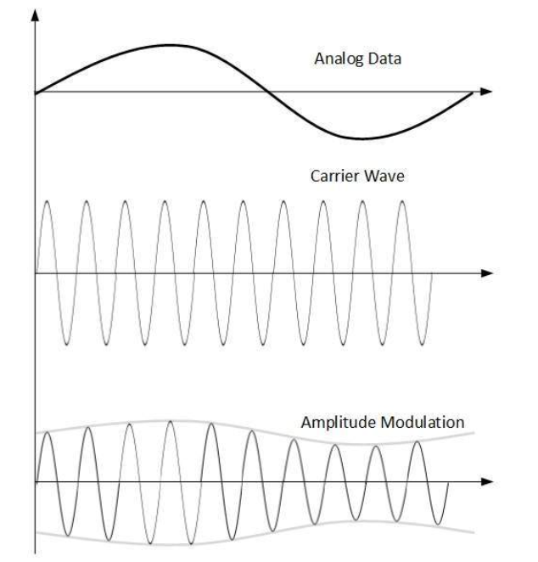
Conti…
Amplitude Modulation
In this modulation, the amplitude of the carrier signal is modified to reflect the analog data.
Amplitude modulation is implemented by means of a multiplier.
The amplitude of modulating signal (analog data) is multiplied by the amplitude of carrier frequency, which then reflects analog data.
The frequency and phase of carrier signal remain unchanged.
SOCS, MIT-WPU

Slide 9
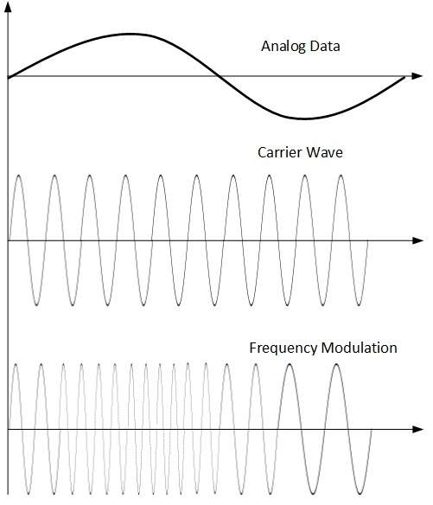
Conti…
Frequency Modulation
In this modulation technique, the frequency of the carrier signal is modified to reflect the change in the voltage levels of the modulating signal (analog data).
The amplitude and phase of the carrier signal are not altered.
SOCS, MIT-WPU

Slide 10
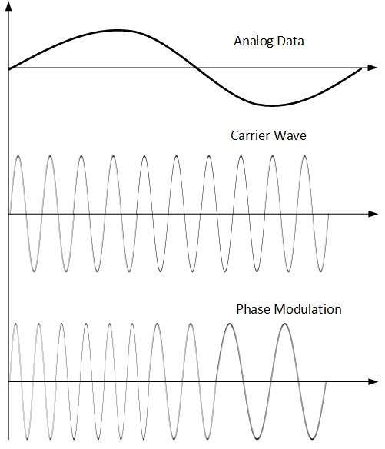
Conti…
Phase Modulation
In the modulation technique, the phase of carrier signal is modulated in order to reflect the change in voltage (amplitude) of analog data signal.
Phase modulation is practically similar to Frequency Modulation, but in Phase modulation frequency of the carrier signal is not increased.
Frequency of carrier is signal is changed (made dense and sparse) to reflect voltage change in the amplitude of modulating signal.
SOCS, MIT-WPU

Slide 11
PHYSICAL LAYER DEVICES : REPEATERS, HUBS- ACTIVE HUB PASSIVE HUB
Repeater
A repeater operates at the physical layer.
Its job is to regenerate the signal over the same network before the signal becomes too weak or corrupted so as to extend the length to which the signal can be transmitted over the same network.
An important point to be noted about repeaters is that they do not amplify the signal. When the signal becomes weak, they copy the signal bit by bit and regenerate it at the original strength.
It is a 2 port device.
SOCS, MIT-WPU

Slide 12
Conti…
2. Hub
A hub is basically a multiport repeater.
A hub connects multiple wires coming from different branches, for example, the connector in star topology which connects different stations.
Hubs cannot filter data, so data packets are sent to all connected devices.
In other words, the collision domain of all hosts connected through Hub remains one.
Also, they do not have the intelligence to find out the best path for data packets which leads to inefficiencies and wastage.
SOCS, MIT-WPU

Slide 13
Conti…
Types of Hub
Active Hub:- These are the hubs that have their own power supply and can clean, boost, and relay the signal along with the network. It serves both as a repeater as well as a wiring center. These are used to extend the maximum distance between nodes.
Passive Hub :- These are the hubs that collect wiring from nodes and power supply from the active hub. These hubs relay signals onto the network without cleaning and boosting them and can’t be used to extend the distance between nodes.
Intelligent Hub :- It works like active hubs and includes remote management capabilities. They also provide flexible data rates to network devices. It also enables an administrator to monitor the traffic passing through the hub and to configure each port in the hub.
SOCS, MIT-WPU

Slide 14
References
http://www.differencebetween.net/technology/difference-between-analog-and-digital-transmission/
https://www.tutorialspoint.com/data_communication_computer_network/analog_transmission.htm
https://www.tutorialspoint.com/data_communication_computer_network/transmission_media.htm
https://www.geeksforgeeks.org/network-devices-hub-repeater-bridge-switch-router-gateways/
https://www.tutorialspoint.com/network-devices-hub-repeater-bridge-switch-router-gateways-and-brouter
SOCS, MIT-WPU

